Slide 1
Notebook Narratives from Industry
Patty Ryan @SingingData
Lee Stott @Lee_Stott
Michael Lanzetta @Noodlefrenzy

Slide 2



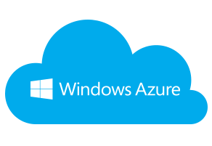
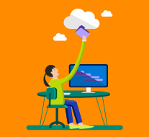

Retail
Sports
Inventory Management Through Deep Learning
Using IoT Sensors and Machine Learning to Up Your Game
+
Professional Services
EDUCATION
=
Distributed Classroom Instruction
Custom Domain Search for Expert Chat
Notes:
Using a single backend environment, App Service allows developers to build Web Apps, Mobile Apps, APIs and Logic Apps.

Slide 3
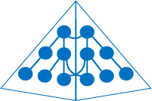


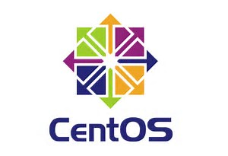


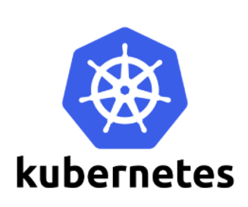
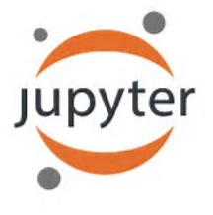
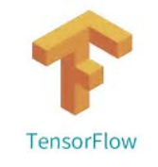


Flexible JupyterHub Connectivity Models
IaaS/PaaS Server & Data VMs/Containers
LDAP/Shibboleth Connected Jupyter Hub
Notebooks.azure.com
LDAP/Shibboleth bind to DSVM JupyterHub
…
Jupyter containers
Virtual network
Azure AD Domain VM w/ Jupyter Hub
Domain join DSVM/JupyterHub
Azure AD Connect / Express Route
Azure AD Domain Services
Azure
Active Directory
RDP/SSH
…
Virtual network
Windows Integrated Authentication
WIA to DSVM & JupyterHub
On Premises Server & Data
Active Directory
…
Virtual network
Linux/Windows JupyterHub
containers/VM or Dedicated Machine
https://aka.ms/archjupyterhub
Notes:
Starting at the bottom we have a typical on premise scenario with VMs, Physical machines or even container based installation of jupyter Notebooks, JupyterHub connecting to local data resources users authenticate via local LDAP, Active Directory or external auth providers such as Microsoft or Google.
On the left hand side we have various different scenarios for authentication and provisioning starting at the top with a LDAP/Shibboleth connected JupyterHub or VM allowing users to Single Sign On.
The next option is using Azure Active Directory to provide Single Sign On to domain controlled VMs or Containers.
The Final scenario is using Windows Integrated Authentication to Single Sign on to VMs or Container based machines
One of the key of utilsing Azure is that we support all operating systems and container management services and allow you to build and run Data Science application on Windows and Linux and provided a dedicated Data Science Virtual Machine fully configured with all the appropriate tools and services for your experiments
Utilizing services such as Azure AD Connect and Azure ExpressRoute allows you create a Hybrid Data Center connecting Servcies and Data hosted in the Azure Cloud directly to the Data and Services on premise.
The final option based on the right had side is utilizing Microsoft Azure Notebooks, This is a free service that provides Jupyter notebooks along with supporting packages for R, Python and F# as a service. This means you can just login using your Microsoft Account and get going since no installation/setup is necessary. Typical usage includes schools/instruction, giving webinars, learning languages, sharing ideas, etc. The service is provided by the Python team @ Microsoft, which is part of the Data Group.
If your interested in understandin the various architecture scenarios in more depth see http://aka.ms/jupterhub

Slide 4

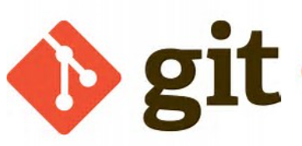
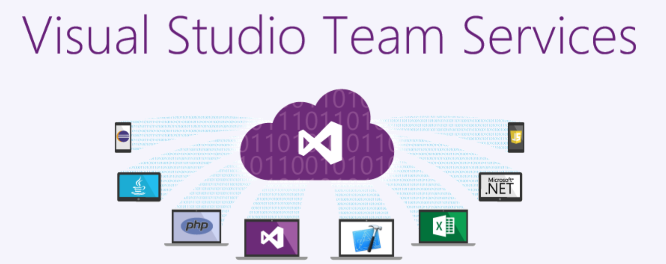


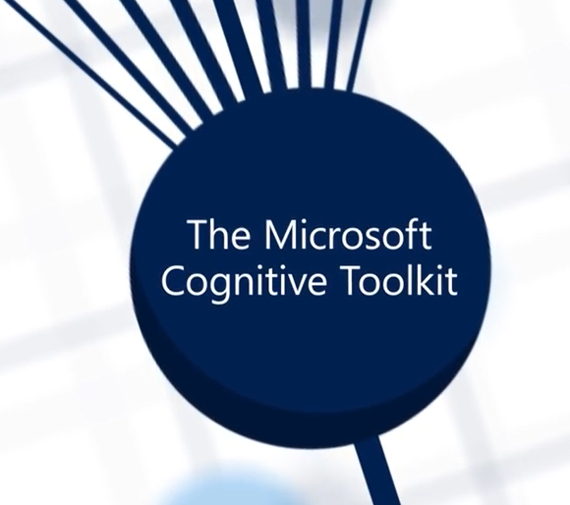
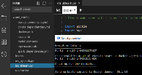



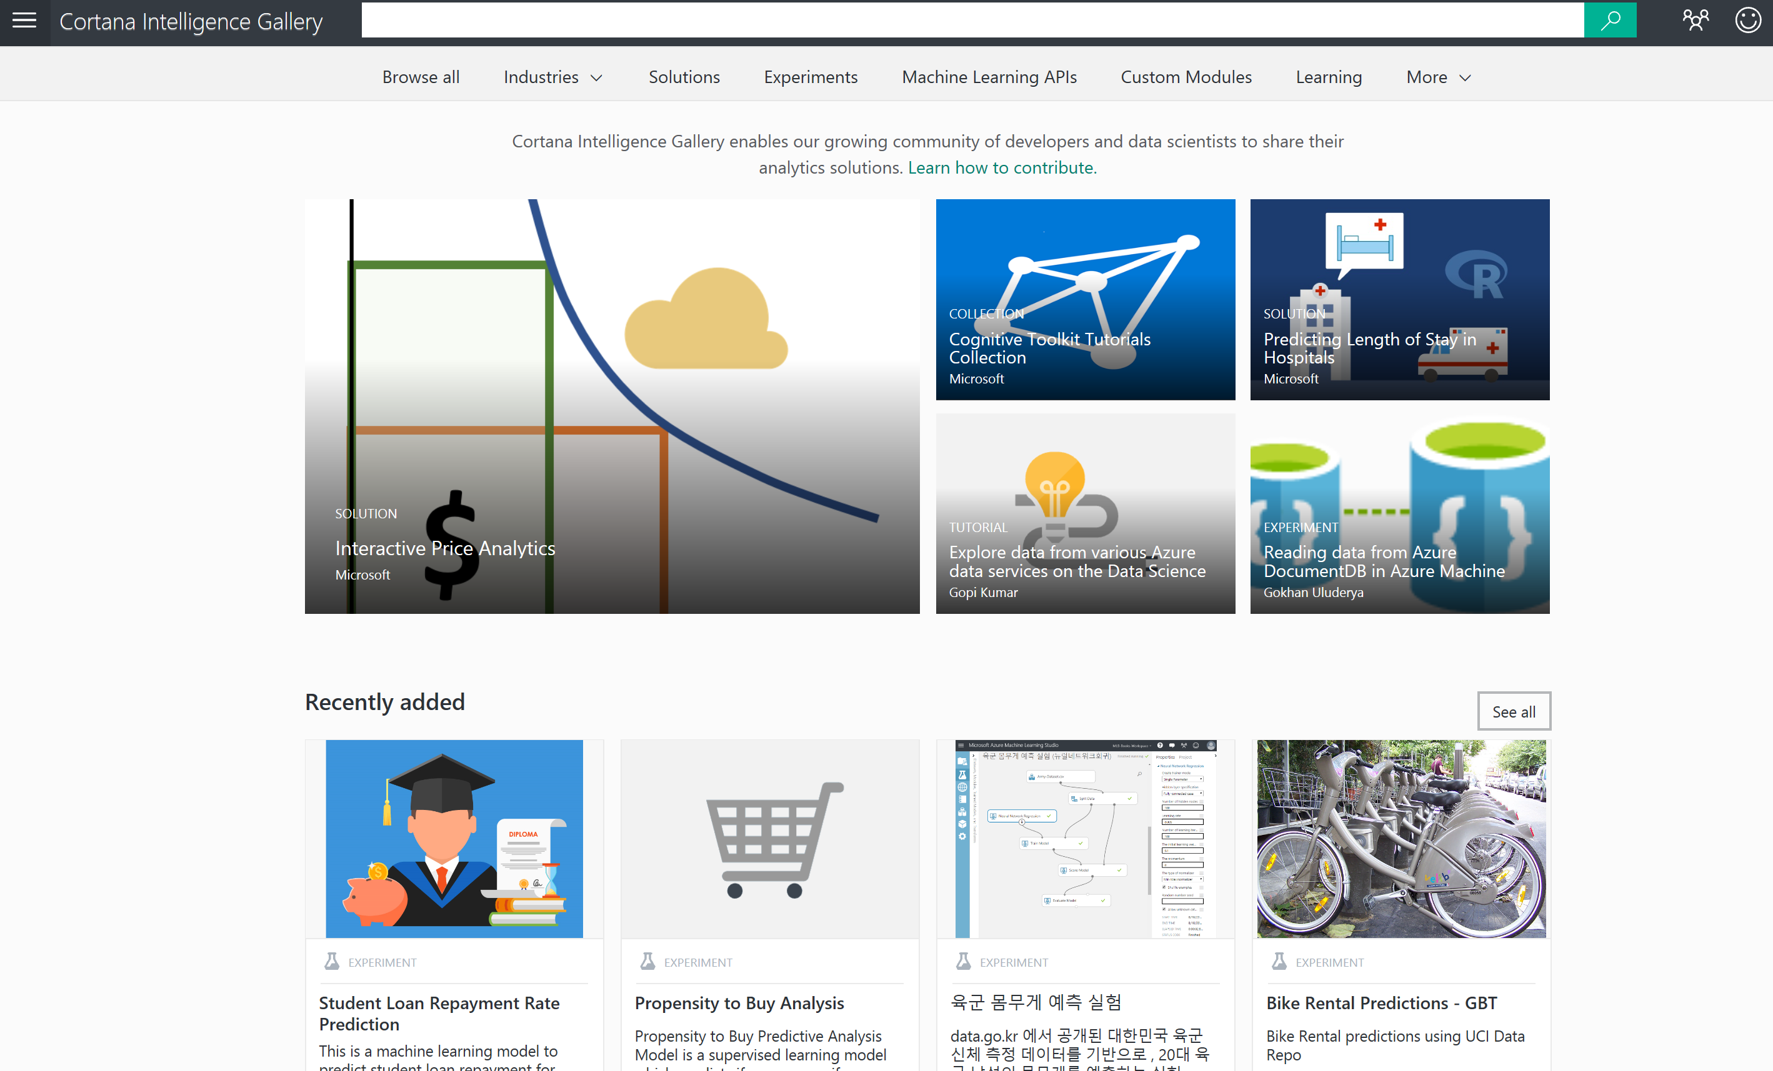
Orientation to Notebook Narratives Tech
Source Control
Cognitive Services
Azure
Intelligence
Azure
Search
Cloud
Data Science VM
Azure Notebooks
Data Lake Store Blob Store
BYOD or
Managed Device
Azure Data Stores
Data
Warehouse
On-Premises
Notebook Creator Workstation
Data/Servers/IoT Devices
Cortana
Intelligence Gallery
Notes:
Users generally utilise Notebooks and associated data and services from the following perspective.
Typically students and academics undertaking Data Science courses access on premise data/services and devices, they typical utilise BYOD devices or lab based managed equipment.
The Cloud access offers services such as Microsoft Data Science VM, Containers and services such as Hdinsight, CNTK, TensorFlow, HDInsight, Spark, Machine Learning and the thousands of community based projects and solutions which are utilised.
Source Control is essential for collaboration and sharing of output so solutions such as VSTS and Github become essential is the distribution & Collaboration of Notebooks and using services such as http://mybinder.org to render and share Notebooks hosted in Github Repos.
Microsoft provides a number of FREE cloud services which are suitable for Data Science/Jupyter users including Microsoft Cognitive Services http://aka.ms/cognitive Azure Notebooks http://Notebooks.azure.com and Azure Machine Learning Studio https://studio.azureml.net/ accessing data on and off premise is also key to your experiments and assignments, Microsoft provides Azure Data Stores and various mechanism for sharing your models and experiment with the world in the form of Cortana Intelligence Gallery https://gallery.cortanaintelligence.com/.

Slide 5
Retail
Sports
Inventory Management Through Deep Learning
Using IoT Sensors and Machine Learning to Up Your Game
+
Professional Services
EDUCATION
=
Distributed Classroom Instruction
Custom Domain Search for Expert Chat
Notes:
Using a single backend environment, App Service allows developers to build Web Apps, Mobile Apps, APIs and Logic Apps.

Slide 6
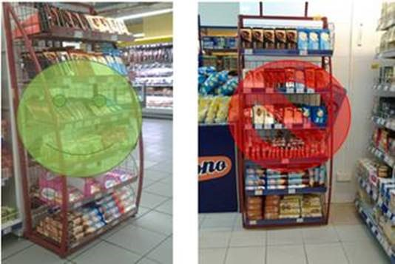
Why Jupyter?
Quick iteration
Easy documentation of assumptions
Shareable evaluator at end of hack
Retail
Inventory Management Through Deep Learning
Notes:
Inventory auditing right now is a painful manual process involving sending workers out to the stores to do ad-hoc assessments on whether shelves adhere to the vendors’ policies. What if we could automate that using Deep Learning models, either running in the cloud or directly on the phone?
We worked with a partner in the chocolate industry in Europe to try and solve that problem, during a week-long Hackfest. We knew that productionalization wasn’t possible during that period and that we had to work fast, and Jupyter allowed us to do that. We could effectively document our assumptions, iterate quickly on the problem and in parallel, and at the end of the hack it was easy to consolidate our work and share it with both the partner and the wider world.
Our team does quite a few short-term engagements like this, coding side-by-side with developers from partners and customers, and Jupyter notebooks have become an invaluable part of our workflow. Now, a little more about our solution…

Slide 7
These Are Not The Shelves You're Looking For
Domain Expertise
Shelf-by-shelf visual inspection
Overall shelf composition
Data, Data, Data
Labeling shelves bounding boxes
Visual Object Tagging Tool Helps (aka.ms/vott)
Finding Shelves Using Deep Learning
Fast R-CNN
Best at time of Hackfest
Better now (Faster R-CNN, YOLO9000, RON)
Notes:
The problem was to classify whether a shelf was correctly stocked or not. To do so we relied on domain expertise from the partner, who using shelf-by-shelf inspection could determine whether the shelf itself was properly composited, and could then give an assessment of the entire unit. We used a tool our team has developed called the Visual Object Tagging Tool (which we’ve open-sourced) to tag images from the partner and construct a labeled dataset just shy of 1000 images. This is far too few to train a model from scratch, so we looked for a pre-trained model we could benefit from. Also, in the context of a Hackfest we were validating an early CNTK 2.0 build, so we chose the best-in-class Object Detection method which already had an implementation from the CNTK team – Fast R-CNN. This method is dramatically faster than the original R-CNN, but has been superseded by more modern methods now (Faster R-CNN, YOLO9000).
To give a bit more detail on the model…

Slide 8
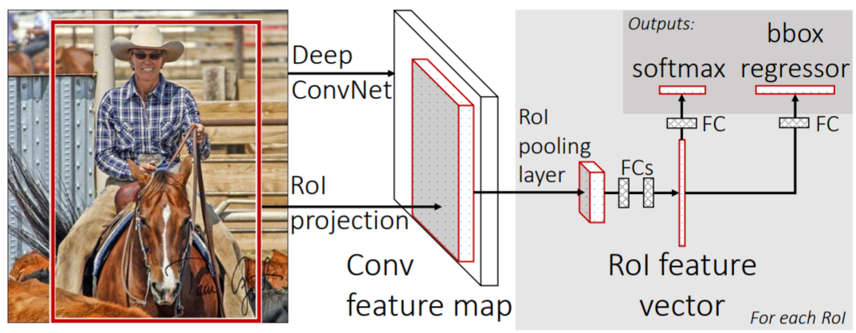
Fast R-CNN In A Nutshell
Faster than “R-CNN”, Slower than “Faster R-CNN” ☺
Regions of Interest (Bounding Boxes)
Traditional ConvNet Used For Feature Extraction
Network Architecture:
Notes:
It works by taking an existing image recognition model (e.g. “this is a cat”) and using the final layer before the “judgment” layer as features to build a new model. That new model spits out not just the class predictions, but also bounding box “adjustments” for where those classes might be (e.g. “here is the cat”) based on the bounding box proposals given as input. The benefit over R-CNN is that this all becomes part of a single neural network, and can thus all be trained together in one step. This was ground-breaking at the time, and the technique has been widely adopted by all new models in the space.
Let’s take a look at the example in Notebook form – unfortunately the partner would not share their labeled data with us, so we’ll be using a “grocery” dataset and classifying items in the fridge.

Slide 9
Demo
Michael Lanzetta
https://aka.ms/jcon2017-retail
https://aka.ms/jcon2017-retail

Slide 10

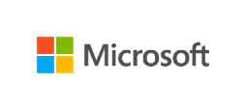


Ernst & Young Custom Search to Power Expert Chat System
We worked with Ernst & Young, a leading global professional services firm, to help them develop and improve a custom search engine to power a self-service expert system. The users of their expert system require an efficient and reliable experience, with a high degree of accuracy in the set of answers provided.
Read the developer blog story on this project here:
https://aka.ms/eycustomsearch
FPO

Slide 11
Demo
Patty Ryan
https://aka.ms/jcon2017-CustomSearch
https://aka.ms/jcon2017-CustomSearch

Slide 12

PSIA-AASI Professional Ski Instructors Association - American Association of Snowboard Instructors
PSIA-AASI evaluates new technology for nurturing learning experiences for developing skiers and snowboarders
Project Goal:
Use wearable IoT sensors in order to develop a machine learning model of skiing skills and expertise levels.
Read the developer blog story on this project here:
https://aka.ms/ds-iotsensor
FPO

Slide 13
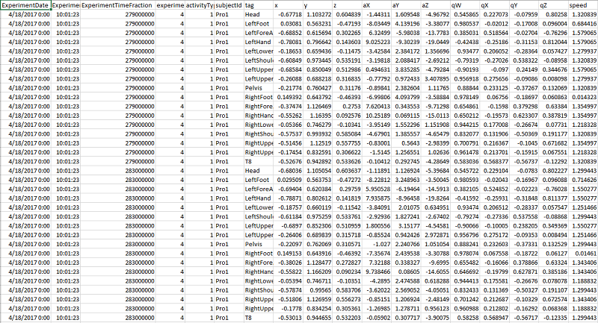
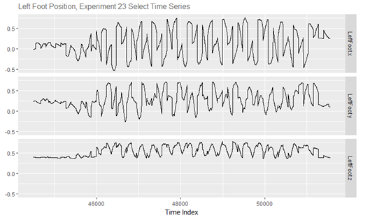
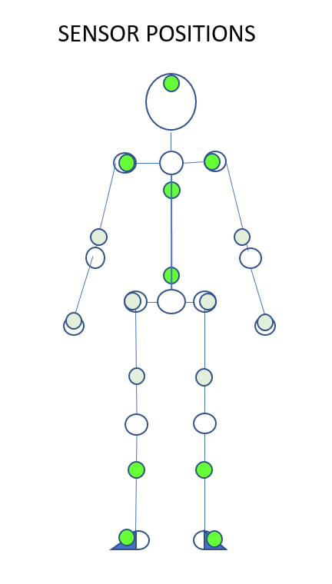
Azure
Intelligence
Machine
Learning
FPO
Azure Data Stores
Data Lake Store Blob Store
On-Premise
Data/Servers/IoT Devices
Azure
Notebooks

Slide 14
Demo
Notebook Overview
https://aka.ms/jcon2017-skisensor https://github.com/CatalystCode/JupyterCon2017/blob/master/Sports_IoTSensorSkillClassification/1_Ski_Sports_IoT_Sensor_Data_Analysis.ipynb
Azure Machine Learning Studio – Cortana Intelligence Gallery
https://aka.ms/ds-iotsensorsml
https://gallery.cortanaintelligence.com/Experiment/Ski-Sport-Sensor-Analysis-and-Modeling
https://gallery.cortanaintelligence.com/Experiment/Ski-Sport-Sensor-Analysis-and-Modeling
Sports Sensor Git Hub - Leverage and contribute!
https://github.com/CatalystCode/sportssensor

Slide 15
Educational Scenarios
Cognitive Services
Azure
Intelligence
Azure
Search
Cloud/ Servers
2
Data Science VM
4
3
Virtual Machine/
Container
Data Lake Store Blob Store
Azure Data Stores
SQL Data
Warehouse
On-Premises
1
Desktop Notebook
Notebook Creator Workstation
5
Data/
Server
Azure
Notebooks
Notes:
Typically within Academia students and academics utilize either personal devices or lab based devices accessing data typically hosted within the Universities infrastructure.
Alternatively institutions can provide cloud hosted servers and infrastructure
Students can access resources from cloud based providers such as dedicated Data Science VMs via RDP/SSH or Http
Academics and IT staff can manage services and deploy managed VMs or Container based services hosting Jupyter Notebooks with Single sign on
Alternatively students and academics can access services such as Data and Services including Jupyter Azure Notebooks directly as a Software as Service Model.
Typically student and academics want access to data and services based on and off campus to enhance learning outcomes as we previously demonstrated with Single Sign On a hybrid data center can be easily created.
During this session I want to share with you some experiences from two of the worlds learning educational institutions and how they are using Jupyer within their teaching, learning and research.

Slide 16

University of California Berkeley Increases student learning with open source Azure service
A new understanding of the world through grassroots Data Science education at UC Berkeley. In an effort to empower more data-driven thinking, Microsoft is working with U.C. Berkeley to help realize its vision of giving every undergraduate easy access to the university’s Data Science Education Program.
To succeed, the program had to be accessible to 1000+ students beyond the realm of computer science. One way the program does this is through a flexible and scalable technology infrastructure that enables students to quickly set up labs for hands-on practice—they don’t have to spend time installing programs or learning nuances of complicated applications.
“By hosting it in Azure, we can control the environment Students just log in and they’re ready to go.”
- Ryan Lovett, Systems Manager for the Department of Statistics at UC Berkeley.
FPO
Notes:
A new understanding of the world through grassroots Data Science education at UC Berkeley
In an effort to empower more data-driven thinking, Microsoft is working with U.C. Berkeley to help realize its vision of giving every undergraduate easy access to the university’s Data Science Education Program. The course is available to 1000+ students beyond the realm of computer science. One way the program does this is through a flexible and scalable technology infrastructure that enables students to quickly set up labs for hands-on practice—they don’t have to spend time installing programs or learning nuances of complicated applications.“By hosting it in Azure, we can control the environment,” said Ryan Lovett, Systems Manager for the Department of Statistics at UC Berkeley. “Students just log in and they’re ready to go.”
Blog story -https://www.microsoft.com/en-us/research/blog/grassroots-data-science-education-uc-berkeley/
YouTube video - https://www.youtube.com/watch?v=3HI4O1mjqHg
http://data.berkeley.edu/news/coursefuture

Slide 17
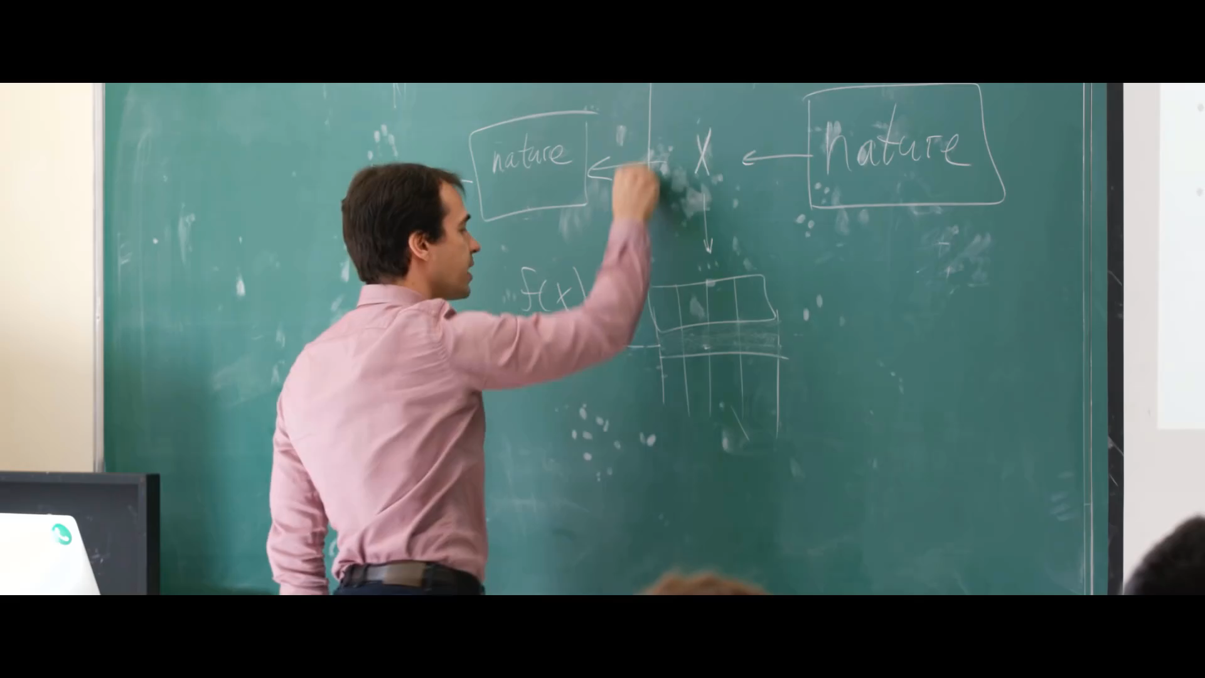
Notes:
Full Video at https://www.youtube.com/watch?v=3HI4O1mjqHg

Slide 18
Demo
Lee Stott
Notebooks across curriculum
http://aka.ms/CognitiveNotebooks
Notes:
There has been a number of sessions at JupyterCon about Berkeley usage of VMs, Containers and Jupyter Notebooks to introduce thousands of students to data science.
A key advantage of Jupyter Notebooks is for the introduction of new services and technologies.
Microsoft Cognitive Services let you build apps with powerful algorithms to see, hear, speak, understand and interpret using natural methods of communication, with just a few lines of code. Easily add intelligent features, such as emotion and sentiment detection, vision and speech recognition, language understanding, knowledge and search. The following demos are to demonstrate how cognitive services can be introduced using Jupyter Notebooks.

Slide 19


University of Cambridge increases student learning with open source Azure service
As the pace of global innovation continues to accelerate, the University of Cambridge is evolving engineering curriculum to teach core concepts faster using higher level, open source tools in the public cloud. For example, a professor increased learning in an introductory computing class by having students use Microsoft Azure Notebooks, which allows them to spend more time mastering concepts and enhancing problem solving skills and less time on language syntax. This technology switch also gives students anytime, anywhere access to required tools needed to complete assignments, and it facilitates greater collaboration between professors, students, and the larger community. In addition, after Cambridge adopted a public cloud solution, IT infrastructure doesn’t limit the ingenuity of bright minds.
“By using Azure Notebooks, students aren’t hindered by installation issues. They can just start working straight away. All they need is a decent browser and an Internet connection.”
- Dr. Garth Wells, Hibbit Reader in Solid Mechanics, Department of Engineering, University of Cambridge
FPO
Notes:
Notes:
Until recently at Cambridge, professors taught required concepts for modeling and simulations using MATLAB, C.
Some professors wanted to evolve the processes and toolsets to be more like modern workplaces and industries, like open source communities.
Dr Garth Wells revamped an introductory computing course using Microsoft Azure Notebooks (Jupyter Notebook).
His course was able to make more complex data processing accessible to the 340 students from multiple locations.
The solution also meant they didn’t have to worry about scalability or whether the system can handle unusual loads or requests.
Examples of student projects include: monitoring population growth, charting crime statistics, et
This Azure solution also enables Professor Wells to collaborate with fellows at other schools on the same ready-to-go research environments.
Executive Summary for Information of the reader
As the pace of global innovation continues to accelerate, the University of Cambridge is evolving engineering curriculum to teach core concepts faster using higher level, open source tools in the public cloud. For example, a professor increased learning in an introductory computing class by having students use Microsoft Azure Notebooks, which allows them to spend more time mastering concepts and enhancing problem solving skills and less time on language syntax. This technology switch also gives students anytime, anywhere access to required tools needed to complete assignments, and it facilitates greater collaboration between professors, students, and the larger community. In addition, after Cambridge adopted a public cloud solution, IT infrastructure doesn’t limit the ingenuity of bright minds.
University of Cambridge increases student learning with open source Azure service
“A lot of my colleagues were concerned that the new course was too difficult. But at the end of the term, those who had taught introductory computing in previous years really marveled at the level that students reached using Azure Notebooks.”
Dr. Garth Wells, Hibbit Reader in Solid Mechanics, Department of Engineering, University of Cambridge
“The idea of fetching data over the Internet, manipulating it, and plotting it would have been completely out of reach for this class using the previous low-level tools, but these kinds of exercises are possible with standard modules in Azure Notebooks.”
Dr. Garth Wells, Hibbit Reader in Solid Mechanics, Department of Engineering, University of Cambridge
“By using Azure Notebooks, students aren’t hindered by installation issues. They can just start working straight away. All they need is a decent browser and an Internet connection.”
Dr. Garth Wells, Hibbit Reader in Solid Mechanics, Department of Engineering, University of Cambridge
Founded in 1209, the University of Cambridge in the United Kingdom is one of the world's leading academic centers with a multi-century reputation for outstanding achievement among its students who include Sir Isaac Newton, Jane Goodall, and Stephen Hawking. Currently ranked fifth in the world by QS World University Rankings, Cambridge also operates one of the world’s largest engineering departments.
To help produce innovative problem solvers, Cambridge is modernizing its engineering program, including introductory computing. Until recently, professors taught required concepts for modeling and simulations using technologies such as MATLAB, C. Students worked with one peer and a professor on projects. Although this model worked for years, professors wanted to adopt new processes and toolsets. “We’re developing a style of teaching that reflects the way people work, in industry and in the open source community,” says Dr. Garth Wells, Hibbit Reader in Solid Mechanics in the Department of Engineering at the University of Cambridge. “And that's very much a collaborative approach supported by open source tools and online services. We also want students to be able to work on computation anywhere, anytime, and on any kind of device.”
Unleashing ingenuity with the cloud
As a first step in realizing his vision, Professor Wells revamped an entry-level computing course, using a web application that allows professors and students to build libraries of sharable notebooks containing text, equations, visualizations, and code. “We wanted to teach higher-level tools like Python, and Jupyter Notebook is the obvious choice for that,” explains Wells. “With it, we can focus more on concepts and problem solving, and less on languages’ syntax. Plus, Jupyter Notebook is open source, so students can use it, along with their knowledge of computation, for any class and at any organization, even a startup.”
Initially, Professor Wells deployed Jupyter Notebook on university servers for a small group of students. “I could see we were going to have issues because we don't have the right resources to scale the solution on our servers to support 340 students, particularly when a good fraction of those will use notebooks in all sorts of strange ways that can cause infrastructure problems,” he says. “Around that time, I met with Kenji Takeda, Director of Microsoft Research Cambridge. He put me in touch with engineers in Seattle,” who were developing a software-as-a-service version of Jupyter Notebook called Microsoft Azure Notebooks.
Wells ended up adopting the initial release of Azure Notebooks for his class instead of managing Jupyter Notebook onsite. “By keeping all technologies in-house, you inevitably have to rein in your ambitions to fit available resources,” he explains. “With Azure Notebooks, we don't have to worry about scalability or whether systems will crash if someone does something out of the ordinary.”
Redefining what’s possible in an eight-week term
The updated computing class was a resounding success. “A lot of my colleagues were concerned that the new course was too difficult. But at the end of the term, those who had taught introductory computing in previous years really marveled at the level that students reached using Azure Notebooks.”
For example, students learned more about plotting data than in previous years by working with public data and open source tools in notebooks. In one lesson, students plotted crime reports in Cambridge by year, month, and category. In another lesson, students created plots with interactive sliders to explore population growth in different regions of the country. “The idea of fetching data over the Internet, manipulating it, and plotting it would have been completely out of reach for this class using the previous low-level tools, but these kinds of exercises are possible with standard modules in Azure Notebooks,” Wells explains. “And I think it’s important for students to use real data in their work. It makes learning more fun. Overusing synthetic data can also reinforce a students’ view that they can compute in the walled garden of a class, but maybe not in the outside world because it’s different.”
Promotes greater innovation and collaboration
Professors can also accelerate research with notebooks. For example, Wells and colleagues at another university are sharing work on a new high-intensity-focused ultrasound technology using Azure Notebooks. Wells also sent a notebook that runs a ready-to-go research environment to a peer in Africa. “He was teaching a class, and only about half the students could properly install the required research tools on their desktops,” says Wells. “By using Azure Notebooks, students aren’t hindered by installation issues. They can just start working straight away. All they need is a decent browser and an Internet connection.”
Moving forward, professors at Cambridge see the use of Azure Notebooks as a strategic step in evolving engineering curriculum. Students can learn more because they focus on key concepts. They also learn how to use increasingly popular open source technologies and collaborative workflows. “With Azure Notebooks, our students get easy access to open source tools from one place,” says Wells. “If they go into a startup after graduation, this is a model that can really work for them. Instead of having to pay $40,000 for software, they only pay for the resources they use. Plus, because the solution simplifies collaboration, students also see that they can get results faster by working with more people.”

Slide 20
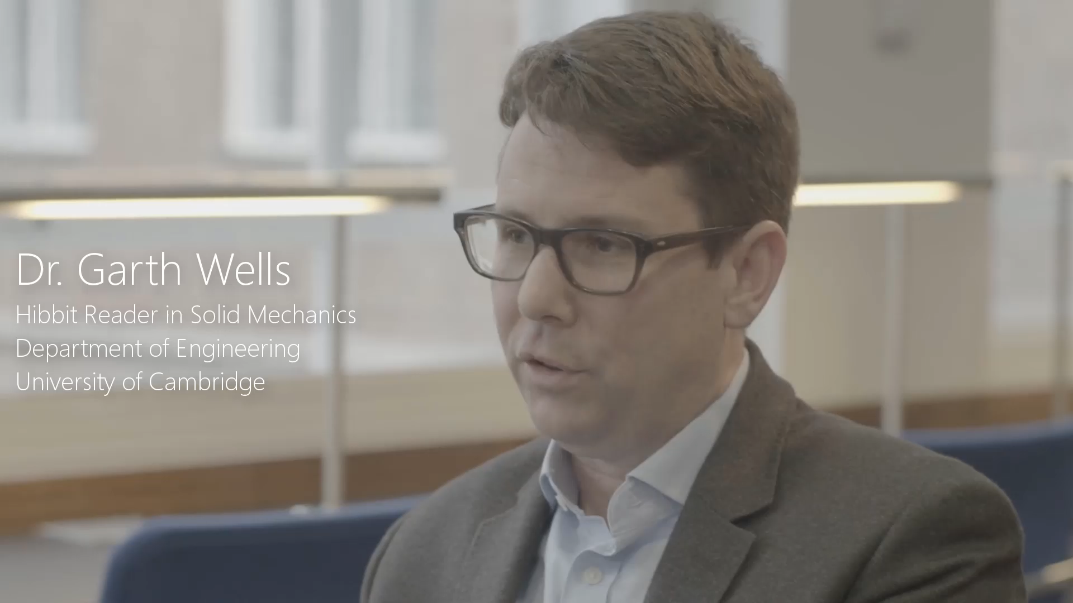

Slide 21
Demo
Lee Stott
http://aka.ms/CambridgeNotebooks
Notes:
In this demo I want to show share with you the Jupyter Notebooks for Mathematics and Engineering at the University of Cambridge
University of Cambridge increases student learning with open source Azure service
“A lot of my colleagues were concerned that the new course was too difficult. But at the end of the term, those who had taught introductory computing in previous years really marveled at the level that students reached using Azure Notebooks.”
Dr. Garth Wells, Hibbit Reader in Solid Mechanics, Department of Engineering, University of Cambridge
“The idea of fetching data over the Internet, manipulating it, and plotting it would have been completely out of reach for this class using the previous low-level tools, but these kinds of exercises are possible with standard modules in Azure Notebooks.”
Dr. Garth Wells, Hibbit Reader in Solid Mechanics, Department of Engineering, University of Cambridge
“By using Azure Notebooks, students aren’t hindered by installation issues. They can just start working straight away. All they need is a decent browser and an Internet connection.”
Dr. Garth Wells, Hibbit Reader in Solid Mechanics, Department of Engineering, University of Cambridge
Initially, Professor Wells deployed Jupyter Notebook on university servers for a small group of students. “I could see we were going to have issues because we don't have the right resources to scale the solution on our servers to support 340 students, particularly when a good fraction of those will use notebooks in all sorts of strange ways that can cause infrastructure problems,” he says. “Around that time, I met with Kenji Takeda, Director of Microsoft Research Cambridge. He put me in touch with engineers in Seattle,” who were developing a software-as-a-service version of Jupyter Notebook called Microsoft Azure Notebooks.
Wells ended up adopting the initial release of Azure Notebooks for his class instead of managing Jupyter Notebook onsite. “By keeping all technologies in-house, you inevitably have to rein in your ambitions to fit available resources,” he explains. “With Azure Notebooks, we don't have to worry about scalability or whether systems will crash if someone does something out of the ordinary.”
Redefining what’s possible in an eight-week term
The updated computing class was a resounding success. “A lot of my colleagues were concerned that the new course was too difficult. But at the end of the term, those who had taught introductory computing in previous years really marveled at the level that students reached using Azure Notebooks.”
Moving forward, professors at Cambridge see the use of Azure Notebooks as a strategic step in evolving engineering curriculum. Students can learn more because they focus on key concepts. They also learn how to use increasingly popular open source technologies and collaborative workflows. “With Azure Notebooks, our students get easy access to open source tools from one place,” says Wells. “If they go into a startup after graduation, this is a model that can really work for them. Instead of having to pay $40,000 for software, they only pay for the resources they use. Plus, because the solution simplifies collaboration, students also see that they can get results faster by working with more people.”

Slide 22

Recap and Questions
Notebook github repo
http://aka.ms/notebooknarratives
For more information:
Microsoft Faculty Blog http://aka.ms/facultyuk
LearnAnalytics.Microsoft.com
Microsoft.com/AI
Microsoft.com/DeveloperBlog
Notebooks.Azure.com
Aka.ms/DSVM
Notes:
With App Service…
You enjoy the benefits of having one service plan, with a single development, management and billing experience for all app types
You can easily integrate your apps with any system, whether in the cloud or on-premise
And you get the proven enterprise capability of Azure’s existing application services

Slide 23


Cortana Intelligence Suite
Information Management
Big Data Stores
Machine Learning and Analytics
Intelligence
Data Sources
Cognitive Services
People
Machine Learning
Bot Framework
Data Factory
Data Lake Store Blob Store
Cortanac
Data Catalog
SQL Data
Warehouse
Data Lake Analytics
Web
Apps
HDInsight
(Hadoop and Spark)
Event Hub
Document DB
Mobile
Apps
Stream Analytics
Bots
Dashboards & Visualizations
Sensors and devices
Power BI
Automated Systems
Data
Intelligence
Action
Notes:
To make this vision a reality, we Cortana Intelligence Suite – a suite of services in Intelligent cloud that transform data into intelligent insights and actions.

Slide 24




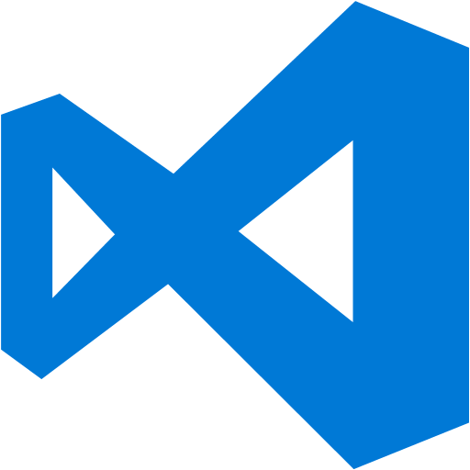















































Platform Services
Security & Management
Compute
Web and Mobile
Developer Services
Hybrid
Operations
Cloud
Services
Service
Fabric
Web Apps
API
Apps
API
Management
Visual Studio
Azure SDK
Portal
Azure AD
Connect Health
Batch
Remote App
Mobile
Apps
Logic
Apps
Notification
Hubs
Team Project
Application
Insights
Active
Directory
AD Privileged
Identity
Management
Multi-Factor
Authentication
Integration
Analytics & IoT
Data
Backup
Storage
Queues
Biztalk
Services
Automation
HDInsight
Machine
Learning
SQL
Database
SQL Data
Warehouse
Operational
Insights
Hybrid
Connections
Service
Bus
Key Vault
Data
Factory
Event
Hubs
Redis
Cache
Search
Import/Export
Store /
Marketplace
Media & CDN
Site
Recovery
Stream
Analytics
Mobile
Engagement
DocumentDB
Tables
VM Image Gallery
& VM Depot
Media
Services
Content Delivery
Network (CDN)
StorSimple
Infrastructure Services
Compute
Storage
Networking
Virtual Machines
Containers
BLOB Storage
Azure Files
Premium Storage
Virtual Network
Load Balancer
DNS
Express
Route
Traffic Manager
VPN Gateway
Application Gateway
Datacenter Infrastructure
Notes:
Why this Slide:
It shows we have a very broad platform. It about BOTH IaaS and PaaS, that these work together. It shows that we continue to lead in world class IT capabilities and that there’s really nothing missing.
Key Points:
We have already seen how the Azure Platform is IaaS + Pass – but I want you to understand that this is a huge number of capabilities – IT building blocks if you will.
Every one of these blocks you provision anytime, self-service anywhere in the world 24x7. You pay for what you use, you can get more or less anytime and you can fully automate everything…
DON’T spent too much time on this slide – you are going to DEMO (aren’t you!!!)… DON’T go through each block…
Transition to NEXT Slide: Make the build go backwards to show JUST IaaS and then you will go to the demo to show it.

